Slide 1
Organ Systems Review

Slide 2
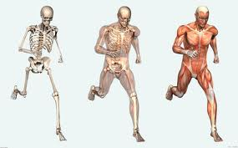
What organ system provides a framework for the body?
Skeletal System

Slide 3
What organ system makes gametes (reproductive cells)?
Reproductive System

Slide 4
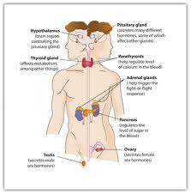
WHAT ORGAN SYSTEM REGULATES AND CONTROLS THE BODY’S FUNCTIONS BY MAKING AND RELEASING HORMONES?
Endocrine System

Slide 5
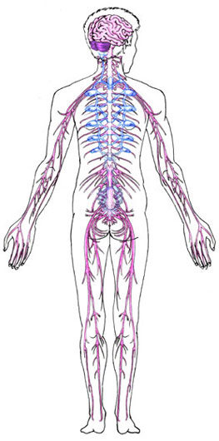
WHAT ORGAN SYSTEM SENDS ELECTRICAL MESSAGES FROM ONE PART OF THE BODY TO ANOTHER?
Nervous System

Slide 6
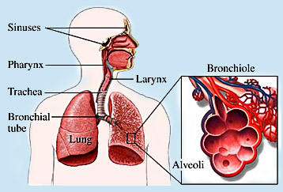
WHAT ORGAN SYSTEM BRINGS OXYGEN INTO THE BODY AND GETS RID OF CARBON DIOXIDE?
Respiratory System

Slide 7
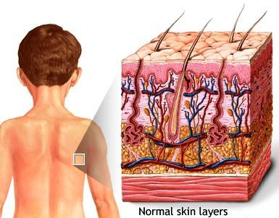
WHAT ORGAN SYSTEM HELPS REGULATE BODY TEMPERATURE AND PROTECTS AGAINST INFECTION?
Integumentary System

Slide 8
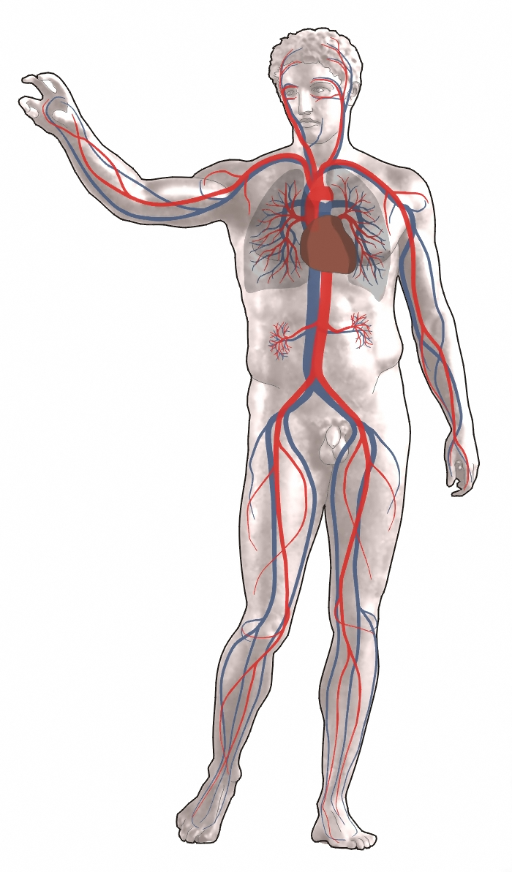
WHAT ORGAN SYSTEM HELPS CARRY OXYGEN AND NUTRIENTS TO ALL CELLS IN THE BODY?
Circulatory System

Slide 9
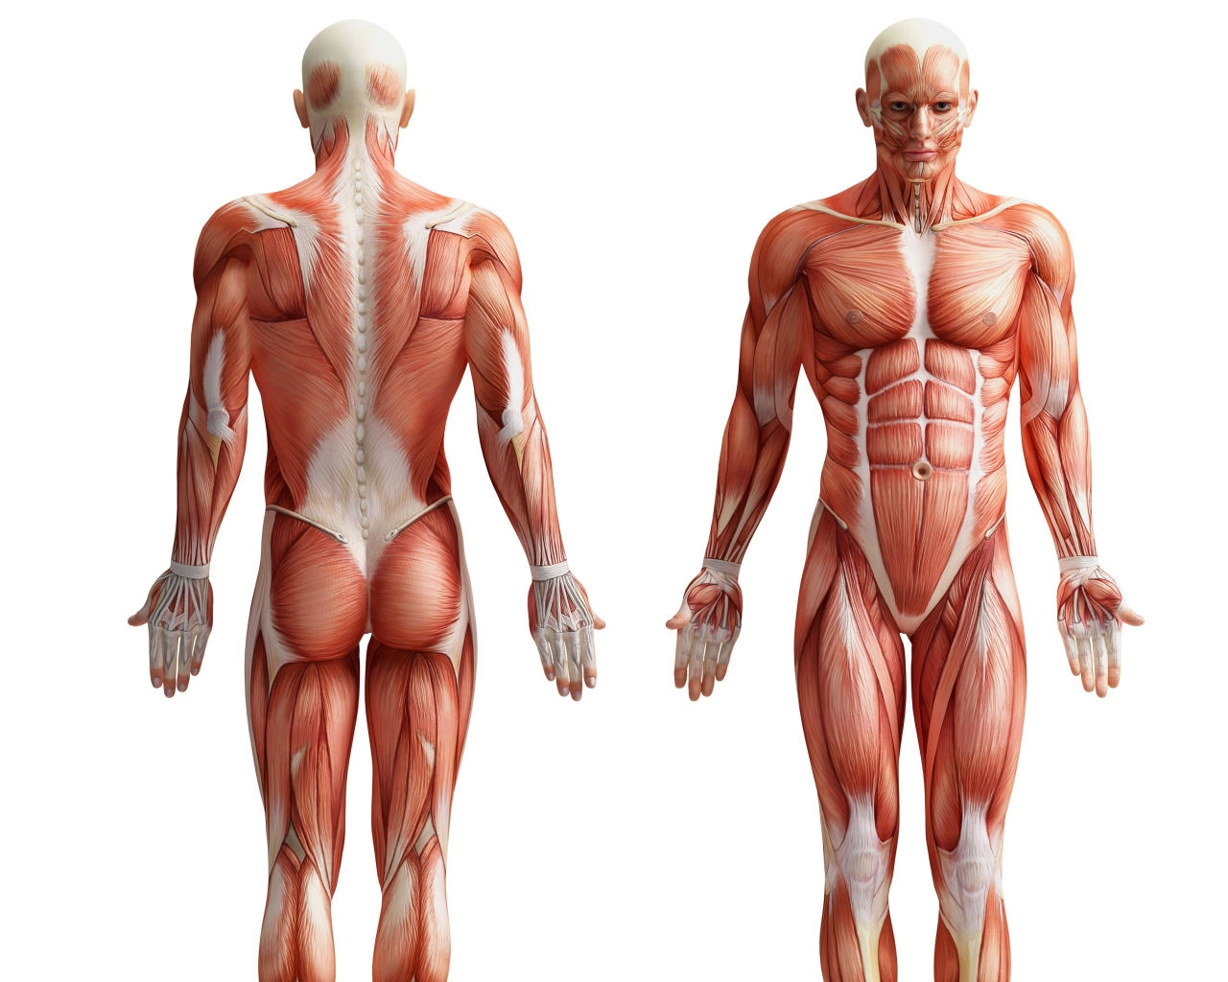
What organ system helps move the body?
Muscular System

Slide 10
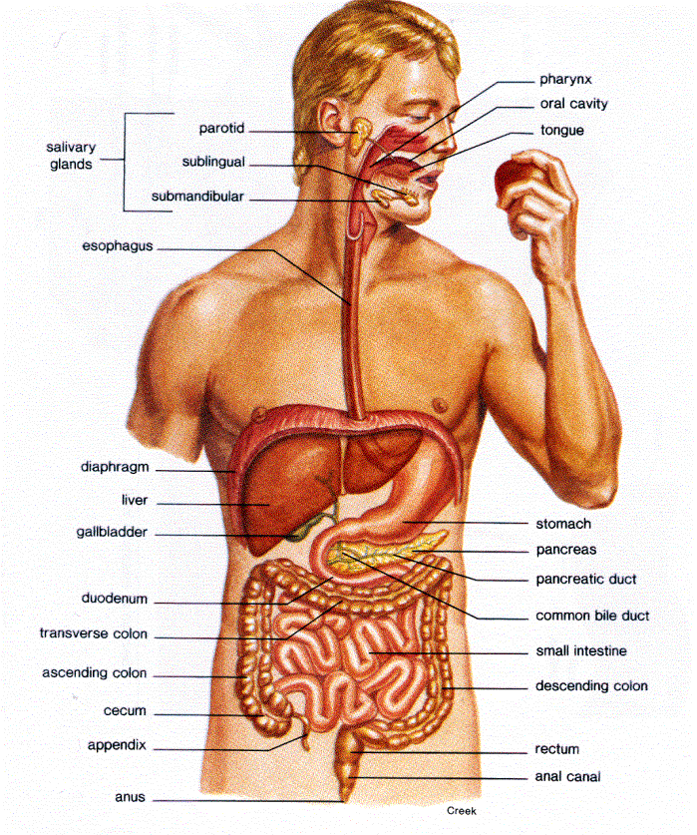
WHAT ORGAN SYSTEM BREAKS DOWN FOOD INTO SMALLER MOLECULES & ABSORBS NUTRIENTS?
Digestive System

Slide 11
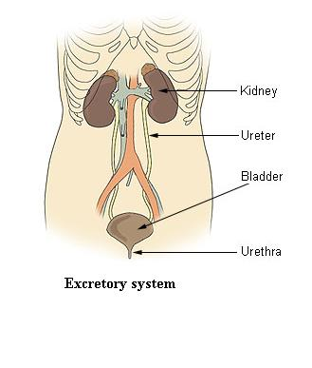
WHAT ORGAN SYSTEM REMOVES WASTE PRODUCTS FROM THE BLOOD?
Excretory System

Slide 12
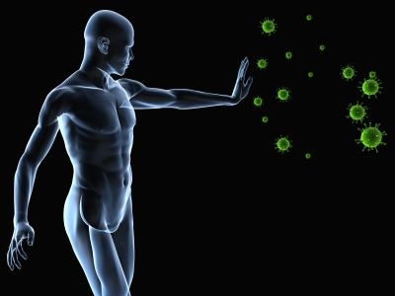
WHAT ORGAN SYSTEM PROTECTS THE BODY FROM DISEASE?
Immune System

Slide 13
What is the function of the respiratory system?
Brings oxygen into the body and gets rid of carbon dioxide

Slide 14
What is the function of the nervous system?
Sends electrical messages from one part of the body to another

Slide 15
WHAT IS THE FUNCTION OF THE INTEGUMENTARY SYSTEM?
Helps regulate body temperature and protects against infection

Slide 16
What is the function of the skeletal system?
Provides a framework for the body & protects internal organs.

Slide 17
What is the function of the endocrine system?
Regulates and controls the body’s functions by making and releasing hormones

Slide 18
WHAT IS THE FUNCTION OF THE DIGESTIVE SYSTEM?
Breaks down food into smaller molecules & absorbs nutrients

Slide 19
What is the function of the circulatory system?
Carries oxygen and nutrients to all cells in the body & takes waste away from cells.

Slide 20
What is the function of the immune system?
Protects the body from disease

Slide 21
What is the function of the muscular system?
Helps move the body

Slide 22
What is the function of the reproductive system?
Makes gametes (reproductive cells) & is responsible for producing a new organism

Slide 23
WHAT IS THE FUNCTION OF THE EXCRETORY SYSTEM?
Removes waste products from the blood (& the body)

