Slide 1
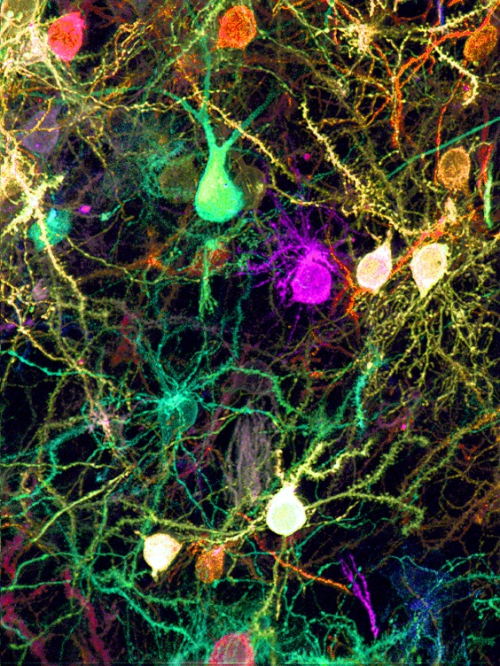
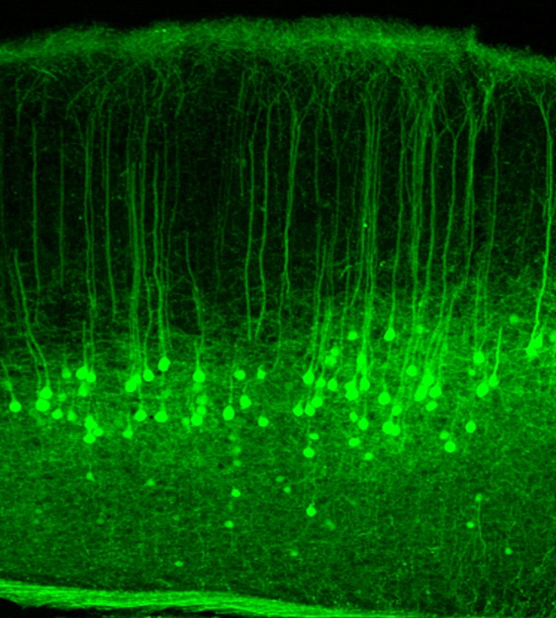
NEURON TRIVIA
About how many neurons are in the human brain?
100 billion
About how many neurons are in the spinal cord?
1 billion
About how long is the longest axon in the world?
15 feet
In which animal would you find it?
In a giraffe - from its toe to its neck.
Notes:
1

Slide 2
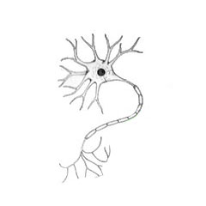
How do “messages” travel along a neuron?
Nerve impulse (an electric current) spreads from point of stimulus on dendrite to axon terminals.
stimulus

Slide 3
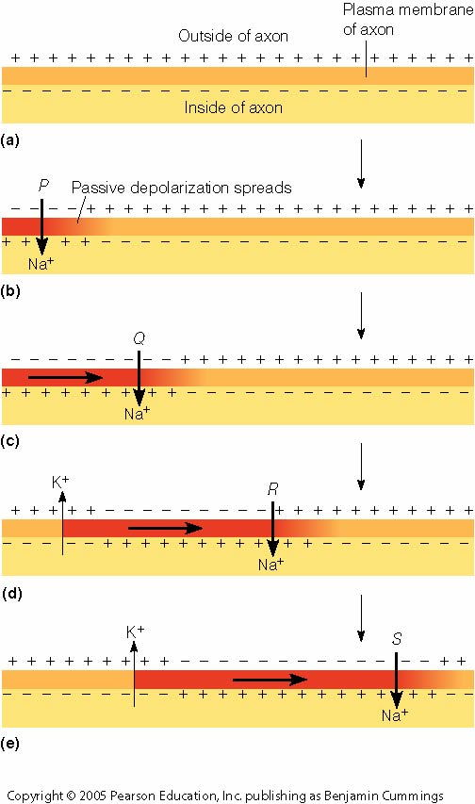
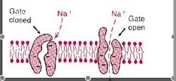
How do “messages” travel along a neuron?
1. At rest: membrane keeps Na+ out. It builds up on outside. Outside is positive (+) relative to inside.
2. Stimulus causes “gates” open, Na+ rushes in. Outside now negative (–) relative to the inside. This causes the next “gates” to open, Na+ rushes in…and so on.
3. Current (the – charge) travels from point of stimulus along membrane to axon terminal.
1. at rest
2. stimulus
A nerve impulse is LIKE DOMINOES!!!
2.
1.
3. Current moves →

Slide 4
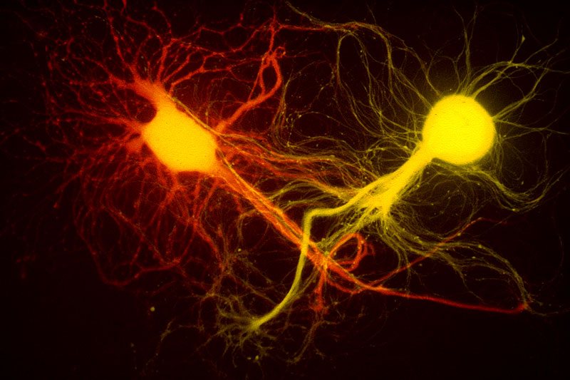
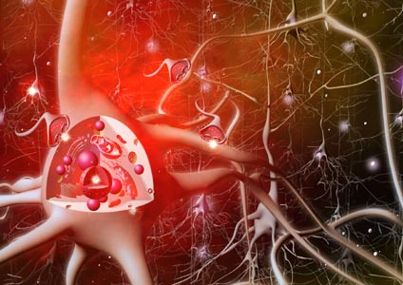
How does a message get from one neuron to the next?
Chemicals (neurotransmitters) travel across tiny gaps between them called SYNAPSES!
SYNAPSE

Slide 5
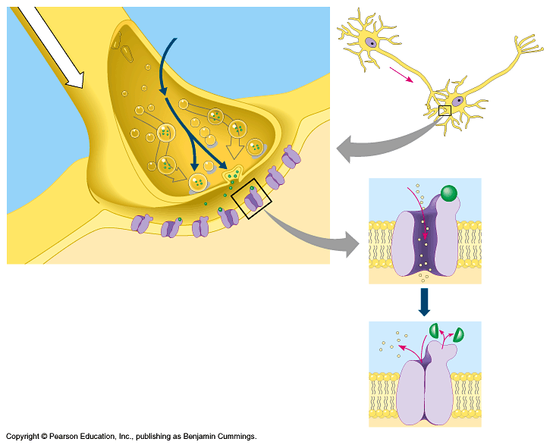
It happens at THE SYNAPSE
One neuron
SYNAPSE (gap)
DENDRITE of next cell

Slide 6
Cell at rest.
The nerve impulse (electric current) moves down axon.
Nerve impulse reaches axon terminal.
Vesicles of neurotransmitters (NT) move to membrane of axon terminal, release NT into synapse. NT diffuses over to dendrite of next cell.
NT binds to receptors on next cell. Binding causes Na+ channels next to receptor to open.
Signal (Electric Current) starts in next cell.
CURRENT
VESICLES of NT
NT BINDS
NT diffuses
Na+ CHANNEL
OPENS

Slide 7
ENLARGED VIEW:
1. Current goes down axon.
1
2. Vesicles move to surface
and release NT into synapse.
3. NT diffuses to next cell.
4. NT binds to receptor. Na+
channels open.
3
4
2

Slide 8
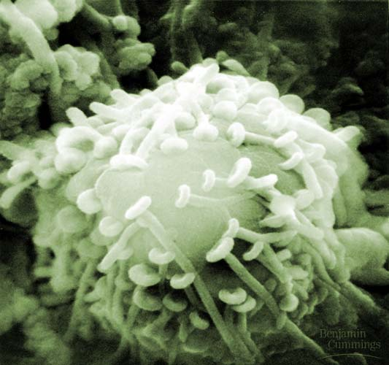
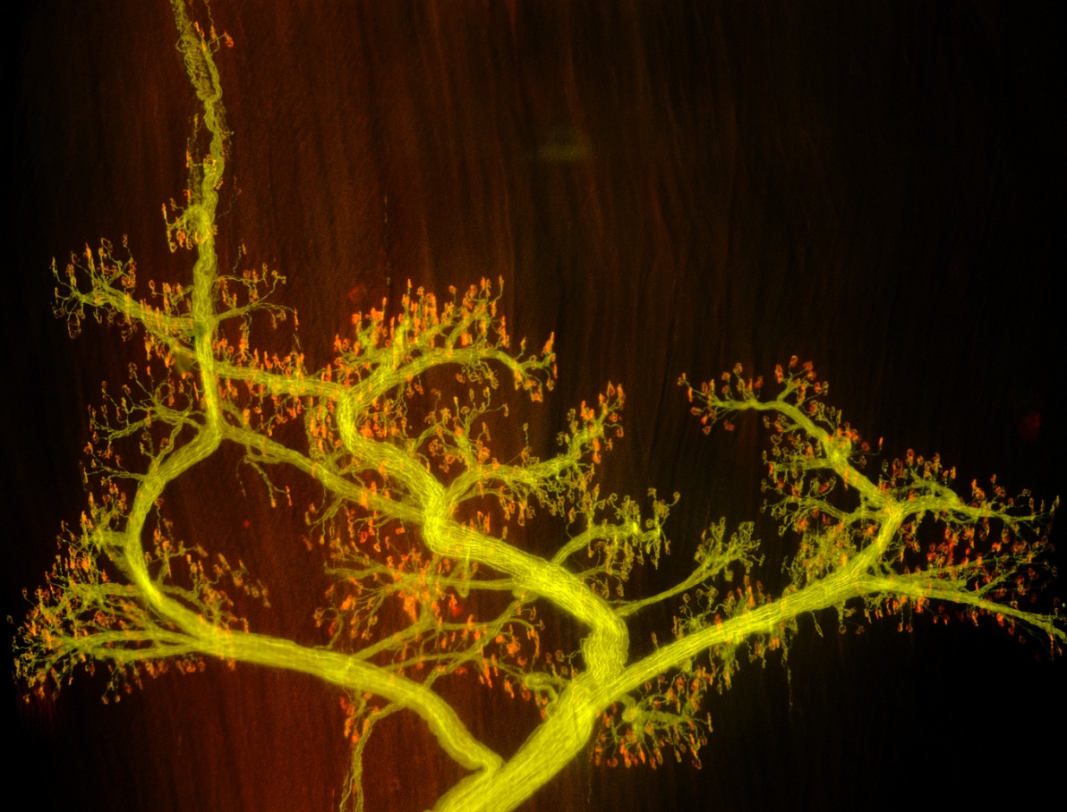
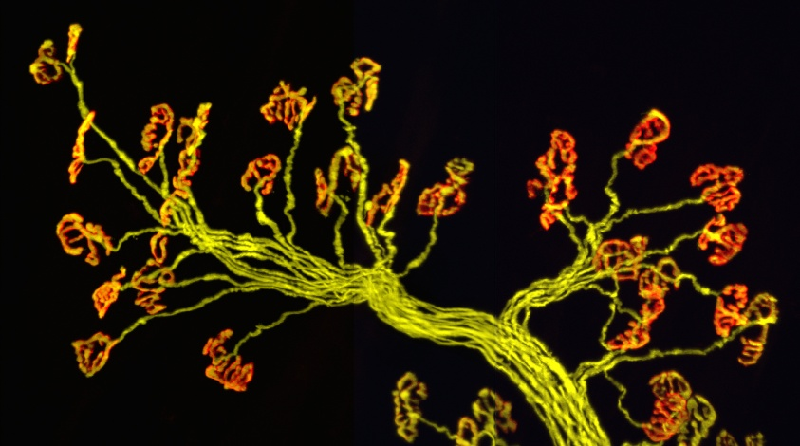
How many synapses does one neuron have?
1,000 to 10,000!!

