Slide 1
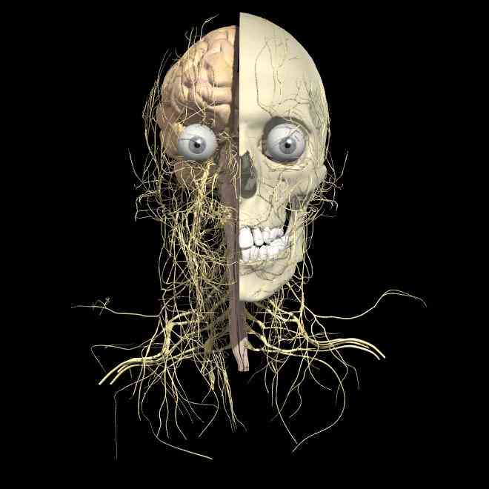
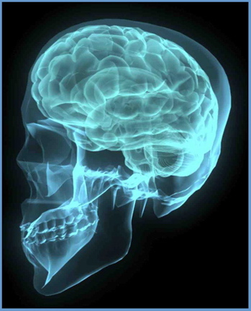
THE NERVOUS SYSTEM
L. Coleman 2009
J. Mitchell 2012
E. Coleman 2008

Slide 2
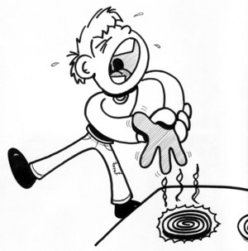
The NERVOUS SYSTEM is responsible for
gathering info about the external or internal environment,
processing the info, and
directing the body to respond.

Slide 3
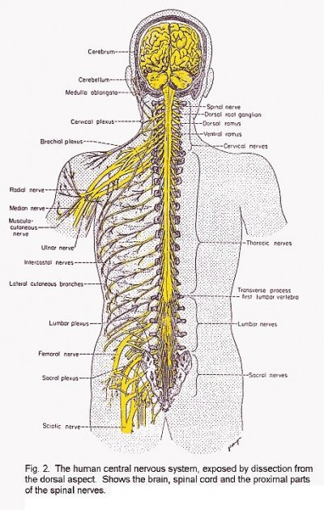
ORGANIZATION OF THE NERVOUS SYSTEM:
PERIPHERAL NERVOUS SYSTEM (PNS):
SENSORY PART
CENTRAL NERVOUS SYSTEM (CNS)
(Brain & Spinal Cord)
MOTOR PART
SKELETAL
MUSCLE
SENSE ORGANS
& RECEPTORS
Sensory neuron
Motor neuron
(Voluntary,
Conscious)
(Voluntary,
Conscious)
INVOLUNTARY
MUSCLES
AUTONOMIC
RECEPTORS
(Heart, breathing, digestion)
(Involuntary,
Unconscious)
Sensory neuron
Motor neuron
GLANDS
(Make hormones,
Enzymes, etc.)
“INPUT” (stimulus)
“PROCESS info”
“OUTPUT” (response)

Slide 4
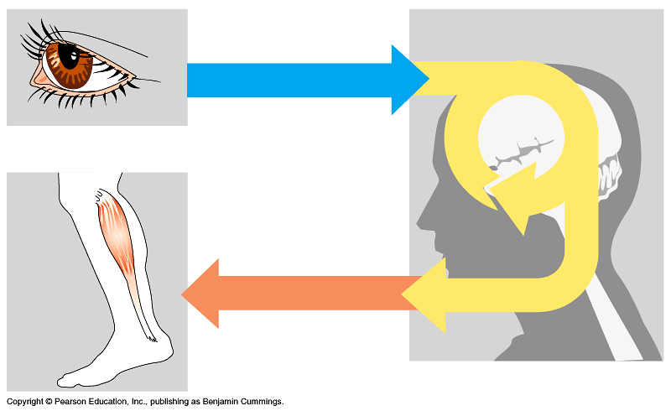
Relationship between Sensory Neurons, Brain, and Motor Neurons (neural pathway)
1. INPUT:
Sensory neurons bring info from environment TO brain.
2. PROCESSING:
Brain interprets info then sends message to PNS
3. OUTPUT:
Motor neurons take orders FROM brain TO muscles or glands.
*Interneurons connect sensory neurons & motor neurons.

Slide 5
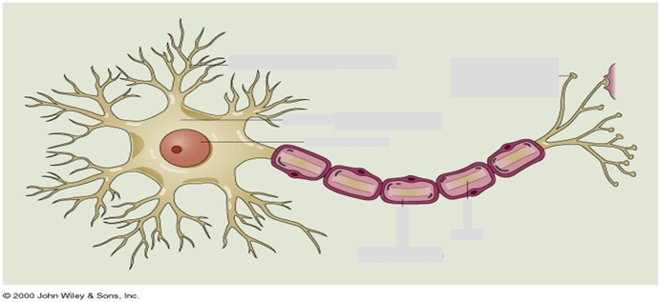
NEURONS – Cells of the Nervous System
CELL BODY
AXON
AXON
TERMINALS
DENDRITES
MYELIN
Cell body: nucleus is located here.
Dendrites: “branches” of cell body; receive impulse from environment or another neuron.
Axon: long projection reaching to nearby neurons. Ends at Axon terminals which contain neurotransmitter.
Myelin: Fatty covering of axon. Speeds up nerve impulses.

Slide 6
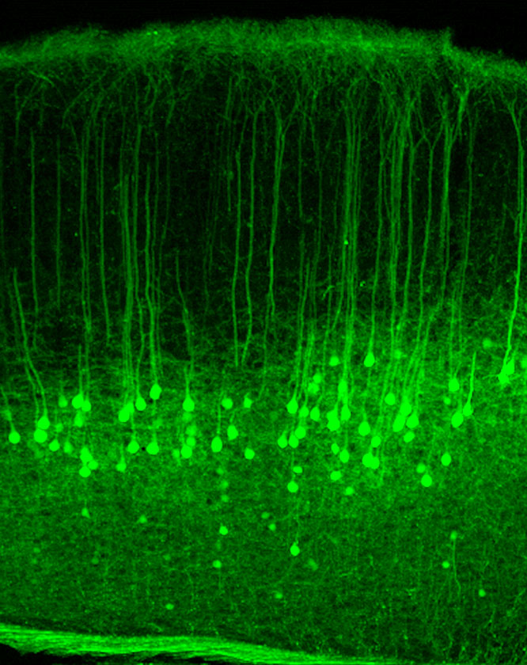
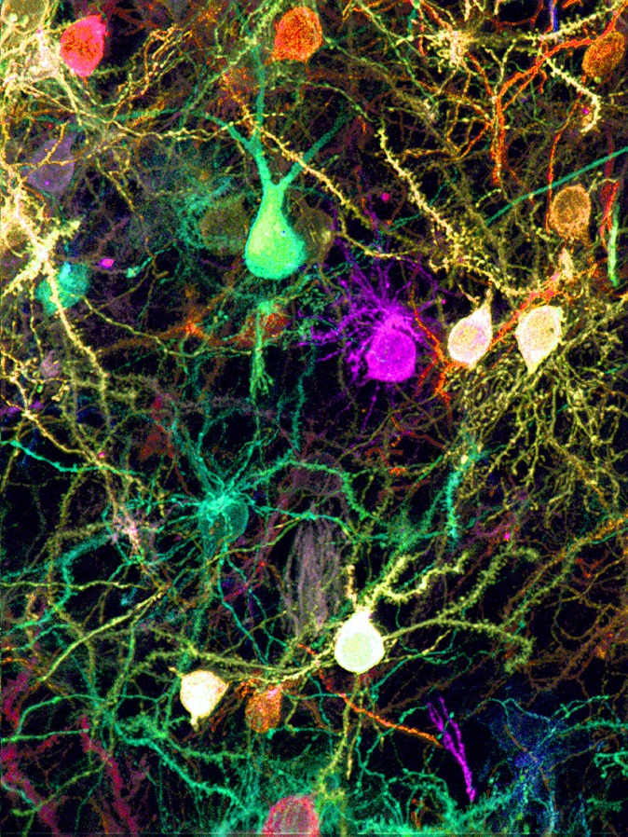
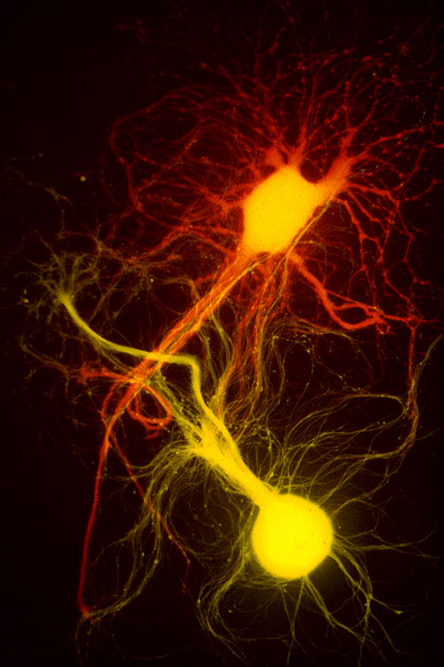
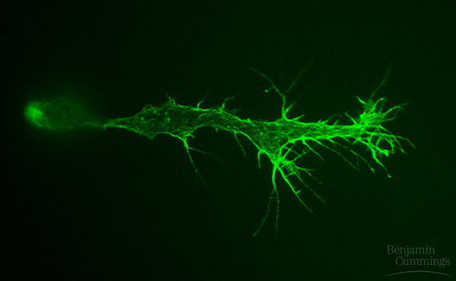
↑
Neurons in cortex
of Brain.
↑
Various
neurons →

Slide 7
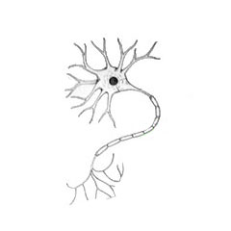
How do “messages” travel along a neuron?
Nerve impulse (an electric current) spreads from point of stimulus on dendrite to axon terminals.
stimulus

