Slide 1
3rd Quarter Benchmark Review

Slide 2
the genetic code for ALL living organisms. Bacteria, plants, dogs, humans all contain this genetic code.
the way an organism looks as determined by its genes or genotype.
formation of a new species.
a random change in DNA that is the source of all new variations in organisms.
related to rates of evolution of species…. happens when species do not go through any periods of change for a very long time.

Slide 3
the combination of genes an organism has, like Ff.
inserting a gene from one organism into the DNA of another organism so that the 2nd organism has instructions for the trait found in the 1st organism.
Ex: inserting a glow gene from a jellyfish into a tobacco plant so that the tobacco plant can glow.
a small circular piece of DNA found in bacteria, which is often used in genetic engineering.
the different forms of a gene, like H for normal hearing and h for deafness.

Slide 4
a chromosomal mutation in which part of a chromosome is deleted.
a chromosomal mutation where a part of 1 chromosome breaks off and joins another chromosome.
a chromosomal mutation where parts of a single chromosome are reversed.
a chromosomal mutation in which part of a chromosome copies itself.

Slide 5
this process causes change in species over time because it selects for individuals with beneficial traits and against individuals with less beneficial traits.
disappearance of a species.
a pattern of inheritance where two or more alleles are dominant, like blood type where Type A and Type B blood are both dominant so people with genotype I^{A}I^{B} have Blood Type AB.
type of reproductive isolation in which 2 populations reproduce at different times; like some flowers opening in the morning while other flowers open late in the day.

Slide 6
combination of chromosomes in females.
a trait that is found on a sex chromosome, like colorblindness is a recessive trait found on the X chromosome.
type of reproductive isolation where 2 populations are physically separated by rivers, mountains, or other geographic features.
a specific role or job for an organism in the habitat it lives in.
type of reproductive isolation in which 2 populations have different mating rituals that prevent them from interbreeding.

Slide 7
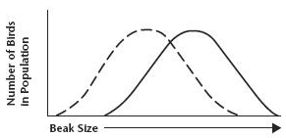
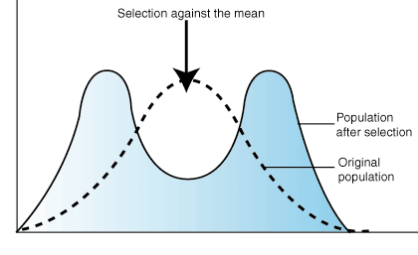
type of natural selection where the entire curve moves because individuals at one end of the distribution curve have higher fitness than individuals at the middle or other end of the curve.
type of natural selection where a single curve splits into two because individuals at both ends of the distribution curve have higher fitness than individuals at the middle of the curve.

Slide 8
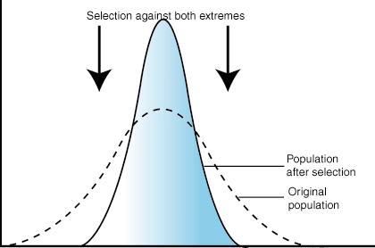
combination of chromosomes in males.
type of natural selection where individuals near the center of the distribution curve for the population have higher fitness than individuals in the outer parts of the curve.

