Slide 1
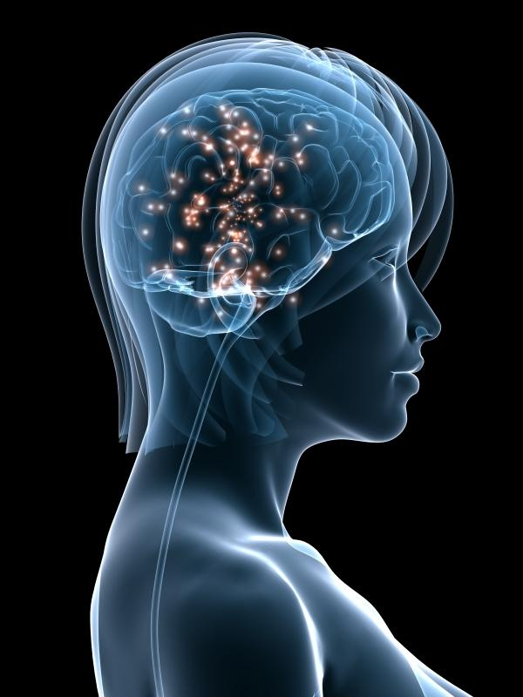
CHANGE AND DEVELOPMENT IN THE NERVOUS SYSTEM:
1. What is happening as we grow and learn?
Short-term:
Every time a specific pathway of neurons is used its synaptic connections get stronger.
HOW?
More NT is produced and more receptors grow on the dendrites.

Slide 2
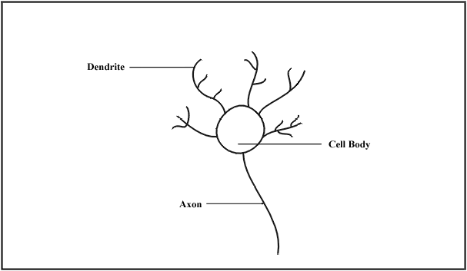
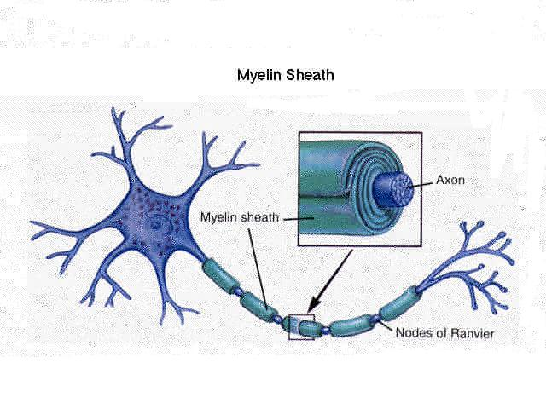
b. Long term: New dendrites & axon terminals grow, new synapses form. Neurons develop more connections.
THIS
becomes
THIS !
c. Speed: As we grow, neurons gain myelin so messages travel much faster.

Slide 3
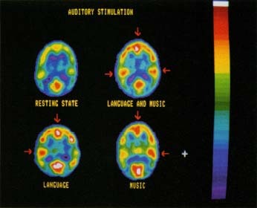
2. What causes these changes to occur?
USING THE BRAIN - that is, THINKING!!
Using the brain stimulates growth of new connections - like using muscle makes them grow bigger and stronger.
What does this mean for the learner?
NO THINKING = NO CHANGES = NO LEARNING!!

Slide 4
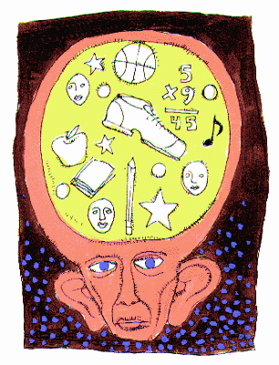
3. What happens if pathways aren’t used?
Connections weaken or are lost.
USE IT OR LOSE IT!

Slide 5
In other words:
LEARNING IS A CONSEQUENCE OF THINKING!
THIS does not work!
You have to do THIS!
↓
↓

Slide 6
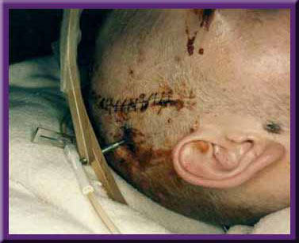
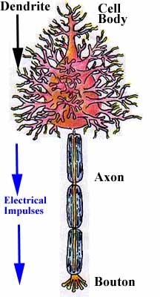
4. Why are people sometimes able to recover some function after a brain injury or nerve damage?
A. BRAIN:
CNS neurons will not re-grow or be replaced, but the brain has PLASTICITY. This means other cells can sometimes be trained to take over function of damaged cells.
B. Nerves in PNS:
Neurons in the PNS can regenerate axons and dendrites, but not cell bodies.
Notes:
6

Slide 7
5. What happens as we age?
Brain loses some plasticity.
Some connections weaken, especially those related to
short-term memory.
New connections will still grow with use.
Brains are the same as muscles as we age -
the more we use them, the less function we lose.

