Slide 1
Cardiovascular SYSTEM
A Transport System

Slide 2
The main function of the cardiovascular system is to transport these things throughout the body:
(1) nutrients (2) water
(3) O₂
(4) waste

Slide 3
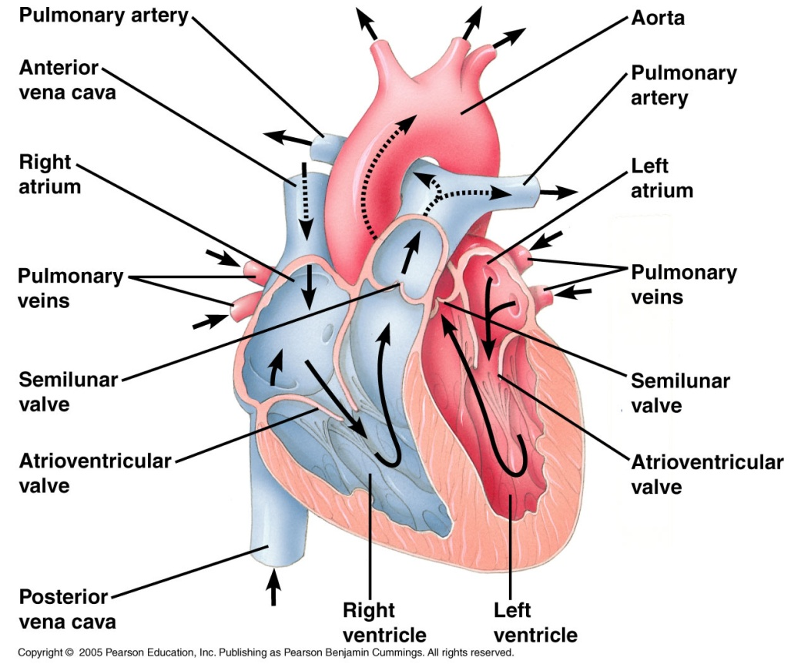
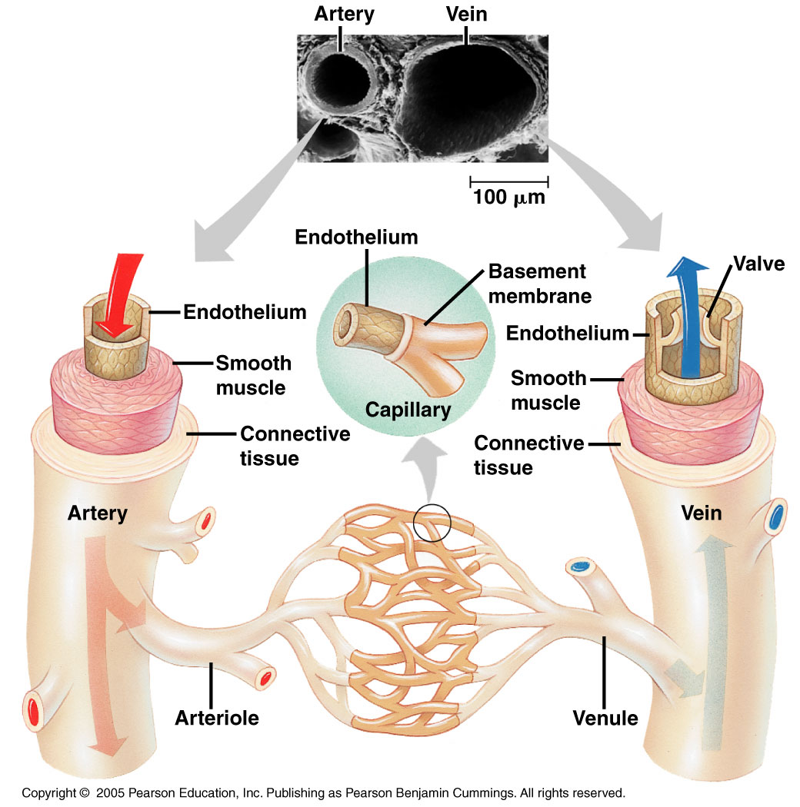
The human cardiovascular
(or circulatory) system has
3 parts:
HEART
(the pump!)
2. BLOOD VESSELS (the tubes)
3. BLOOD

Slide 4
Our circulatory system is a double system.
Two complete circuits: one takes blood to the lungs, one takes it to the tissues of the body.
Lungs
the right side of the heart receives deoxygenated (low in O₂) blood & sends it to the lungs.
the left side of the heart receives oxygenated (high in O₂) blood & sends it to the cells of the body.
Body cells

Slide 5
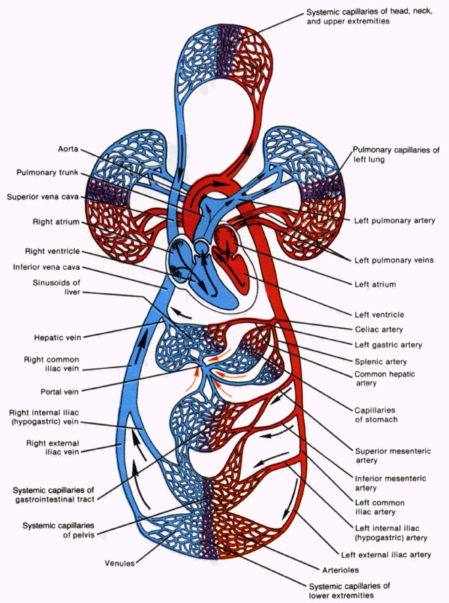
THE HEART IS A
“DOUBLE PUMP”
LEFT side pumps
blood to the BODY.
RIGHT side pumps
blood to the LUNGS.

Slide 6
How does the Heart work?
STEP ONE
blood from the lungs
blood from the body
The heart beat begins when the heart muscles relax and blood flows into the atria.

Slide 7
STEP TWO
Pacemaker electrically stimulates the atria to contract causing valves to open to allow blood into the ventricles.

Slide 8
STEP THREE
Valves close to stop blood from going back.
Ventricles contract forcing
blood out through aorta (left side) and pulmonary artery (right side).
At the same time, atria are relaxing and once again filling with blood.
The cycle then repeats itself.

Slide 9
LET’S SEE HOW IT WORKS.
MY VIDEO
Left and right sides pump together.

Slide 10
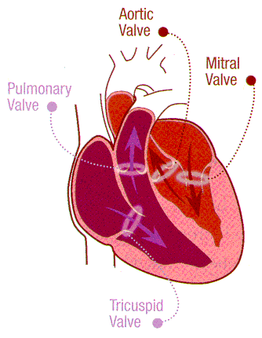
4 valves are essential to heart’s efficiency
4. Aortic Valve
3. Mitral
Valve
2. Pulmonary
Valve
*Valves keep blood moving forward - no backwash!
Tricuspid
Valve
1.

Slide 11
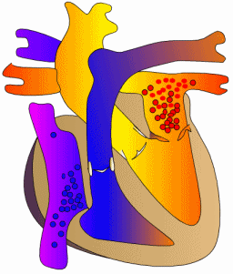
When a heart valve is defective (in this case the Mitral Valve):
Less blood moves forward with each contraction, same blood
is moved again and again, & the heart is overworked.

Slide 12
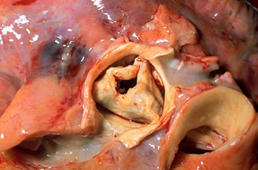
Example of valve disease. Aortic valve stenosis

Slide 13
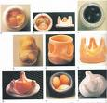
Defective or damaged valves can be replaced with artificial valves:

Slide 14
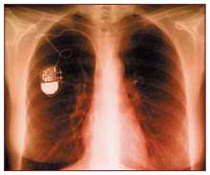
If the heart beats irregularly an artificial pacemaker may be needed.
Electrically
stimulates the heart
causing it to contract.
Runs on a battery.
X-ray of artificial
pacemaker.

