Slide 1
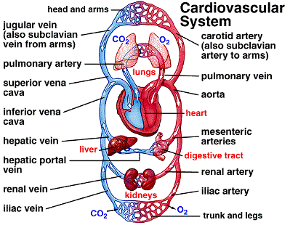
The “vascular” part of the system is a network of tubes.
3 types of blood vessels:
1. ARTERIES
2. VEINS
3. CAPILLARIES

Slide 2
1. ARTERIES:
FUNCTION: Vessels that carry blood away from the heart.
STRUCTURE of arteries: thick muscle and elastic fibers
the thick muscle contracts to push blood along.
elastic fibers allow it to stretch under pressure

Slide 3
2. VEINS:
FUNCTION: Vessels that carry blood to the heart.
Valves in veins stop blood from going backwards.
STRUCTURE of veins: thin muscle and elastic fibers
Skeletal muscles surround veins. When they contract, veins are squeezed and blood is pushed forward.

Slide 4
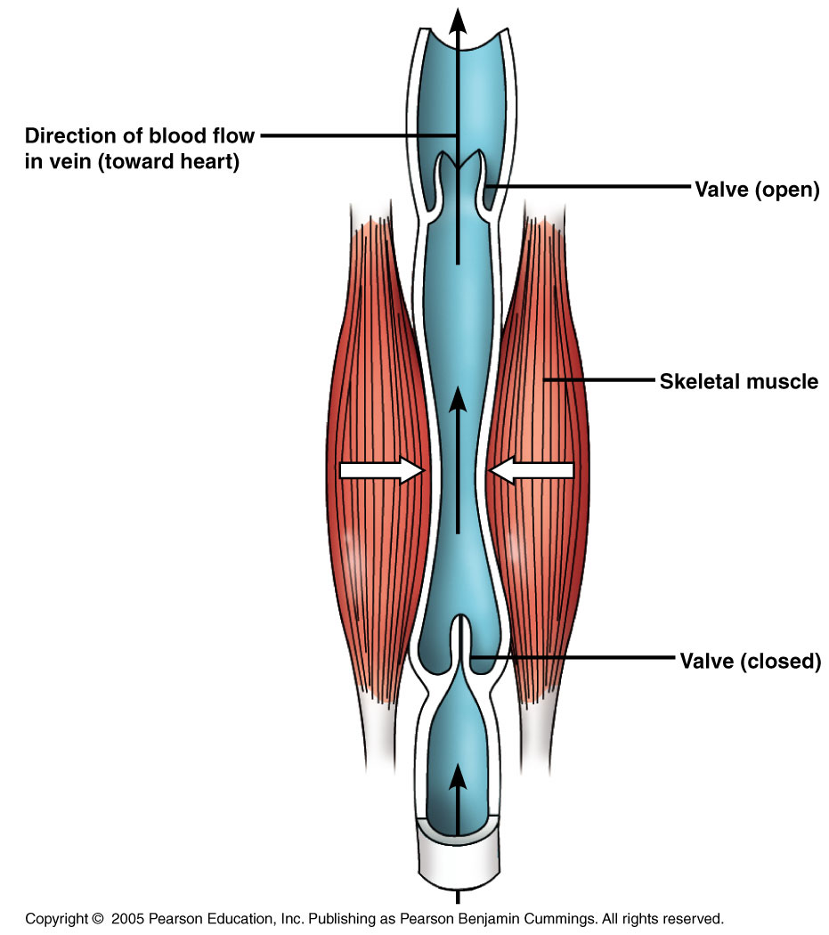
What keeps blood moving in veins?
1. Skeletal muscle contractions
push blood forward in veins.
2. Valves prevent blood from going backwards.

Slide 5
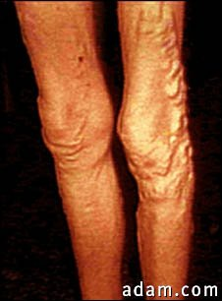
As we age, walls of veins and valves may weaken and
stretch resulting in a condition called varicose veins.
Varicose veins

Slide 6
3. CAPILLARIES:
FUNCTION: Capillaries link Arteries with Veins
*O₂, CO₂, food, waste, & water diffuse through walls & are exchanged with body cells.
*Exchange of materials (H₂O, O₂, nutrients, waste) ONLY OCCURS IN CAPILLARIES.
Structure of capillaries: walls of capillaries are
only 1 cell thick – materials easily pass between these cells.

Slide 7
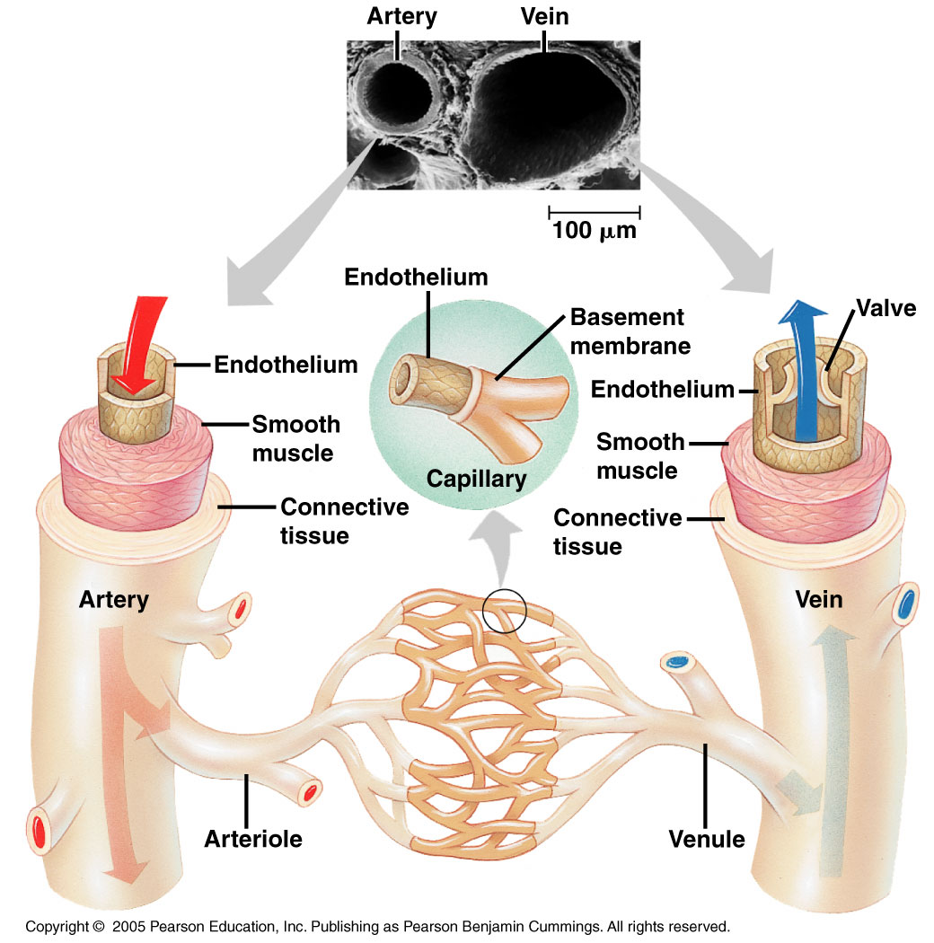
Relationship between arteries, veins, & capillaries:
Blood always travels
from the heart through
vessels in this order:
1. ARTERY
↓
2. CAPILLARY
↓
3. VEIN
* The veins then carry it back to the heart.
3
1
2

Slide 8
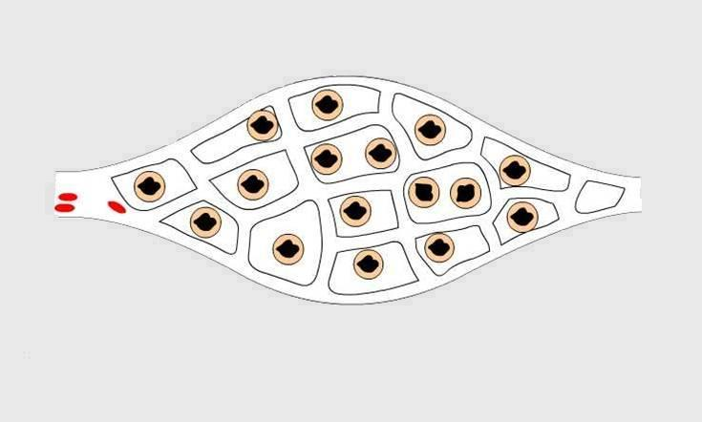
Every body cell is within 2 cells of a capillary.
(A network of capillaries is known as a capillary bed.)
* Blood always flows from artery to capillary to vein.
artery
vein
capillaries
body cell

Slide 9
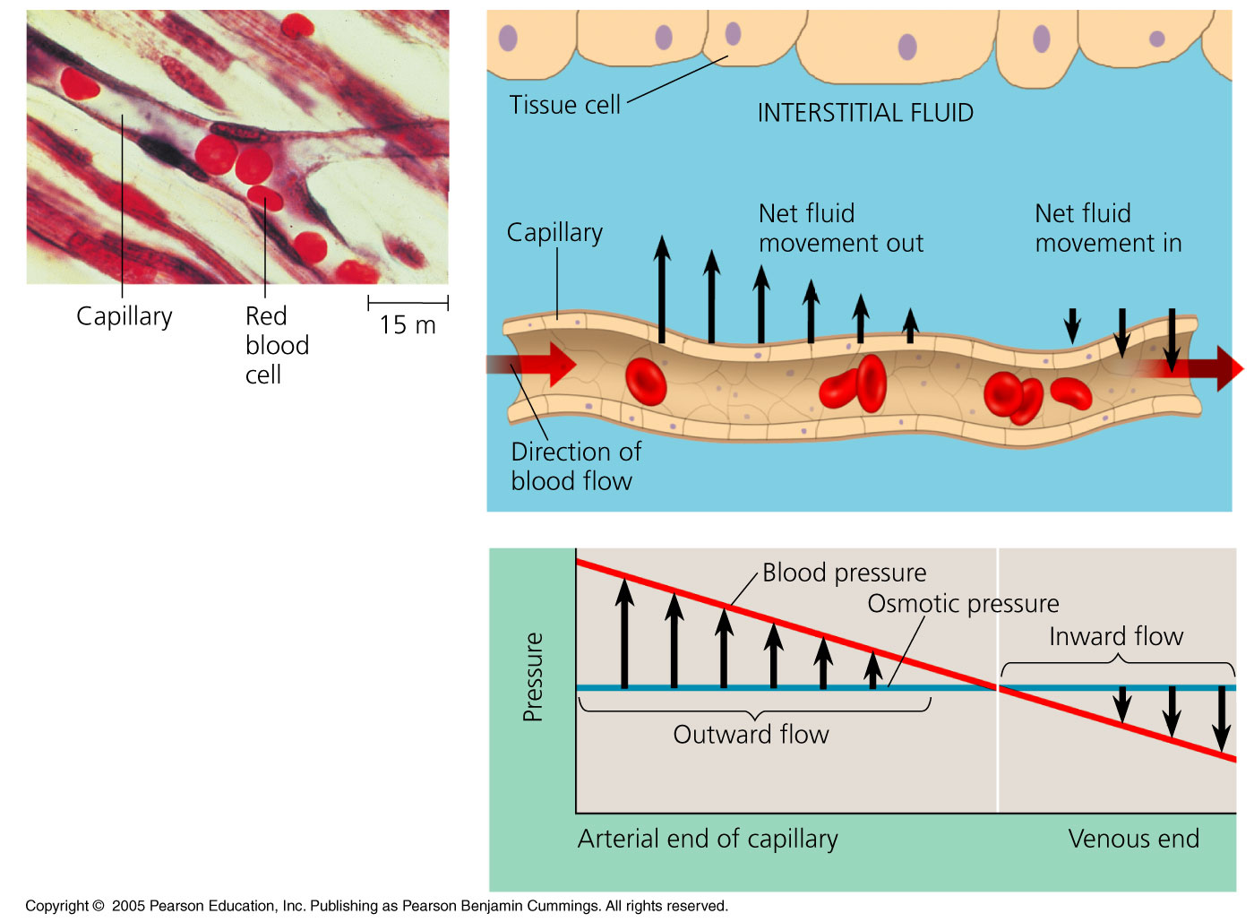
Red blood cells travel single file
through capillaries.

Slide 10
2 main components of blood: CELLS and PLASMA. Blood is a fluid & carries many things:
digested food molecules
red blood cells
white blood cells
BLOOD
O₂
waste (urea)
CO₂
platelets
plasma
hormones

Slide 11
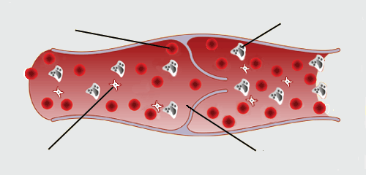
4 MAIN COMPONENTS OF BLOOD
1. red blood cell (RBC)
2. white blood cell
(WBC)
3. platelets
4. plasma

Slide 12
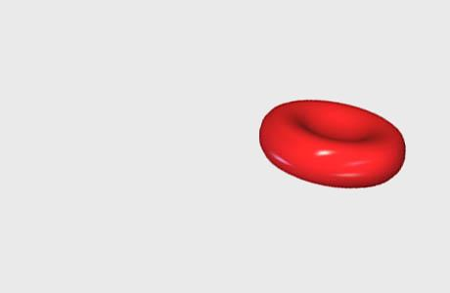
1. Red Blood Cells (RBCs):
*No nucleus
*Just a package of hemoglobin (an oxygen-carrying protein)
* “Squishable” - change shape without breaking to squeeze through capillaries.
Live about 4 months, then are replaced.
Get “beat up” from squeezing through capillaries. No nucleus so can’t divide or replace parts. Age and deteriorate rapidly.

Slide 13
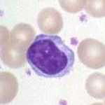
2. White Blood Cells (WBCs)
* Part of the immune system.
* Main function is to protect against disease.
* All have a large nucleus.
* Can leave the bloodstream to “patrol” for invaders.

Slide 14
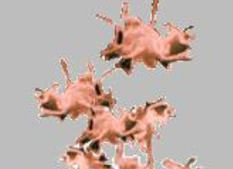
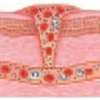
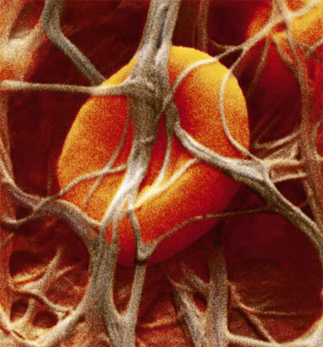
3. PLATELETS:
*Platelets are pieces broken off of larger cells. Help blood to clot.
*Clotting: Platelets produce a tiny net of protein fibers that trap other blood cells.

Slide 15
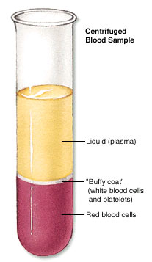
ALSO contains dissolved:
4. PLASMA:
carbon dioxide
glucose
amino acids
proteins
minerals
vitamins
hormones
waste materials
(like urea).
* Straw-colored liquid.
* About 54% of blood.
* 90% of plasma is water.
* Carries cells, platelets, nutrients, & waste.

Slide 16
SELF-CHECK
CAN YOU COMPLETE THE FOLLOWING without LOOKING AT YOUR NOTES?
Arteries take blood ___________ the heart. The walls of an artery are thick, _________ and elastic. Veins carry blood ________ the heart and also have valves. The _________ link arteries and veins, and have a one cell thick wall. Blood is made up of 4 main things: ______, the liquid part of the blood; Red Blood Cells to carry ______; White Blood cells to protect the body from disease, and _________ to help blood clot.
away from
muscular
towards
capillaries
plasma
oxygen
platelets

Slide 17
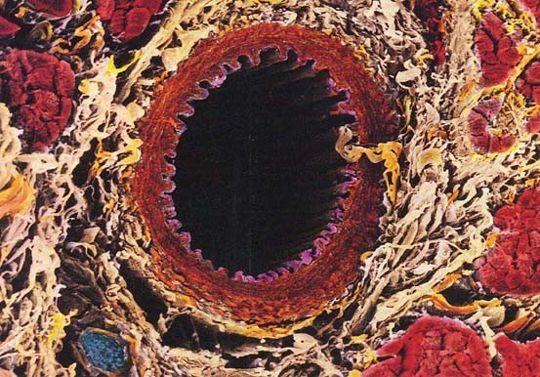
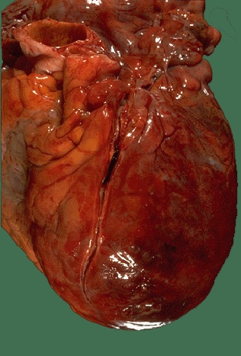
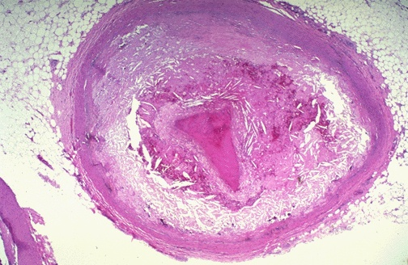
What is the #1 cause of death in the U.S.?
* Cardiovascular disease - disease of the arteries that causes heart attack and stroke. (29% of all deaths)
Healthy artery
Clot in Coronary Artery
Diseased artery - almost
completely blocked.
HEART ATTACK

Slide 18
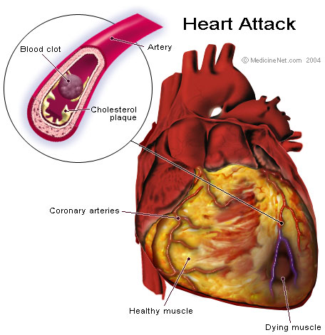
HEART
ATTACK
Blockage in a coronary artery reduces or cuts off blood supply (& O₂) to part of the heart.
A blood clot is the most common cause of blockage.

